Slide 1


Slide 2
BIRTH ASPHYXIA
Presented By :
BNS 1st year
sunita thapa ,suruchi regmi
Rollno:23,24

Slide 3
BIRTH ASPHYXIA
Introduction
Degree
Risk factor and causes
Pathophysiology
Clinical manifestations
Effects
Management

Slide 4
Birth asphyxia
Birth asphyxia is clinically defined as failure to initiate and maintain spontaneous respiration following birth.
Perinatal asphyxia is the more appropriate term which is often continuation of antepartum and intra partum event .
Perinatal asphyxia is the medical condition resulting from deprivation of oxygen to the fetus or neonate during the birth process resulting in inadequate tissue perfusion and physical harm usually to the brain

Slide 5
Degree of birth asphyxia
Mild birth asphyxia (5-6) | Moderate birth asphyxia (3-4) | Severe birth asphyxia (0-2)
Jittery or hyperalert | Lethargy or hypotonic | Comatose, hypotonic
Poor feeding | Feeding difficulty | No feeding, severe apnea
Normal or fast breathing | Occasional apnea | convulsion
Typically last for 24-48 hours | Resolve within 1 week | May improve over several weeks

Slide 6
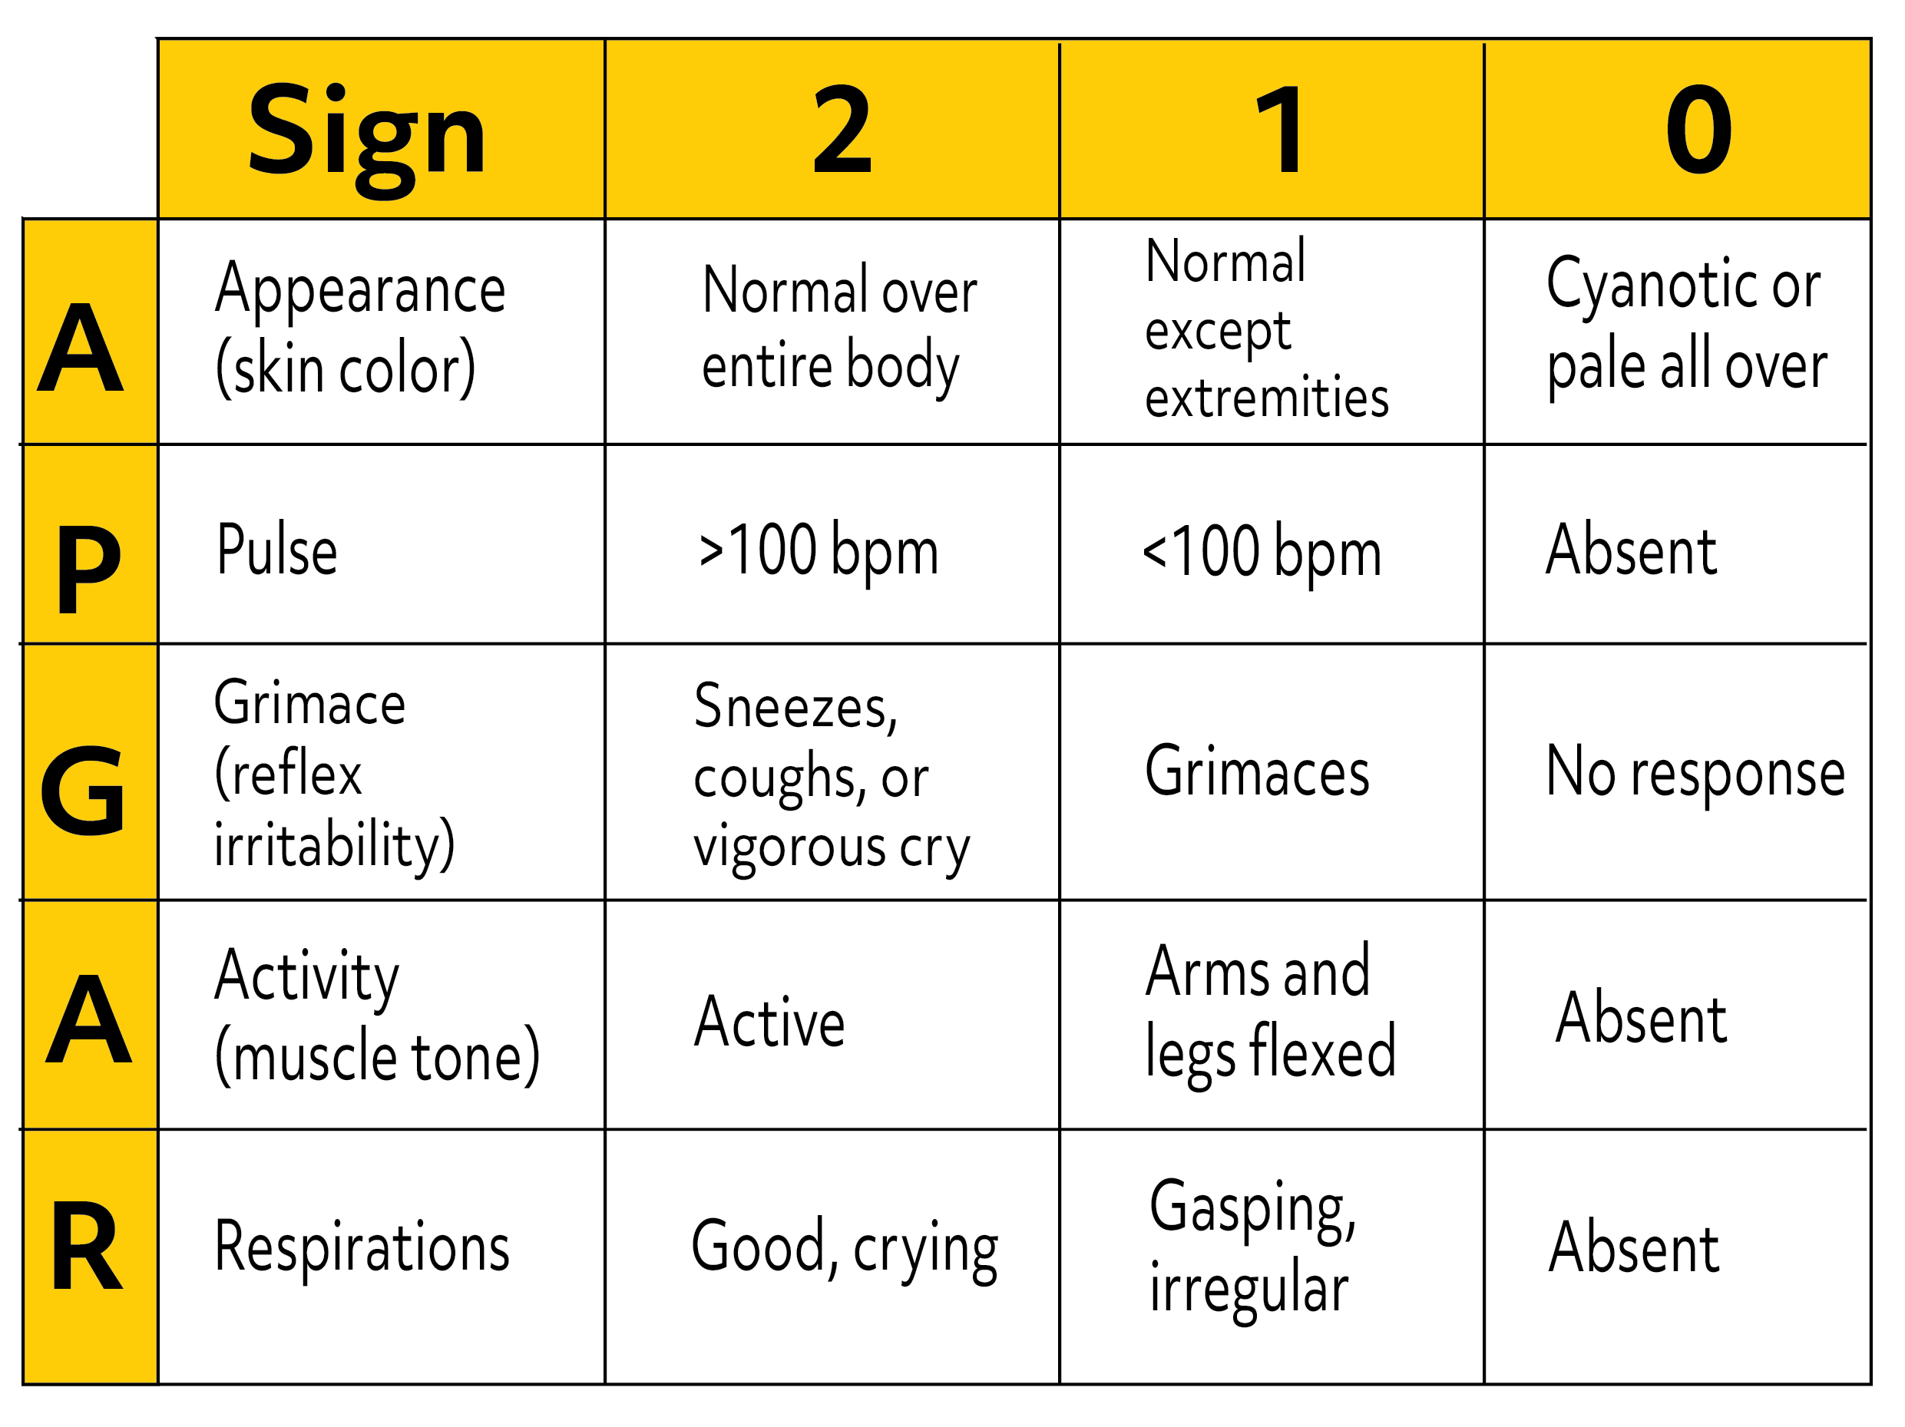

Slide 7
Risk factors
Antepartum | Intrapartum
Maternal diabetes , maternal drug abuse | Elective or emergency c/s
Pregnancy induced hypertension | Precipitous/prolonged labor
Chronic HTN , previous RH sensitization | Prolonged second stage of labor
Maternal age >35 or <16 | Premature labor
Bleeding in second or third trimester | Abnormal presentation
No prenatal care , maternal infection | Rupture of membranes >24 hours
Polyhydraminous or oligohydraminous | Foul –smelling amniotic fluid
 | Prolapsed cord

Slide 8
Causes
The maternal diseases
Placental factors
Problems related to birth and labour
Prenatal and intranatal medication
Postnatal factors

Slide 9
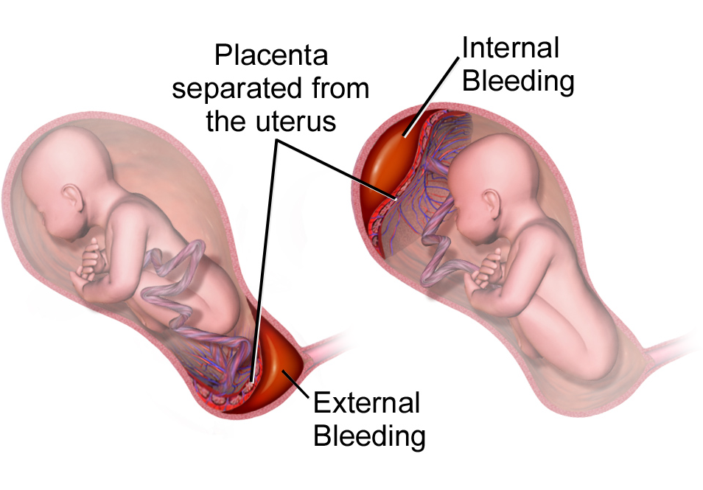

Slide 10
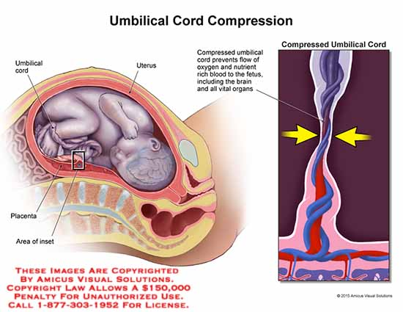

Slide 11
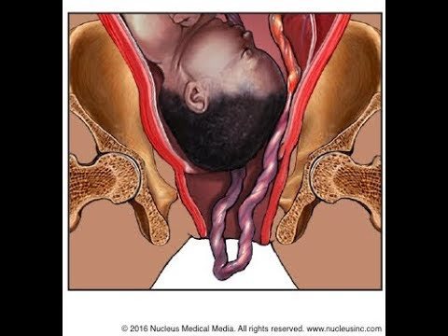

Slide 12
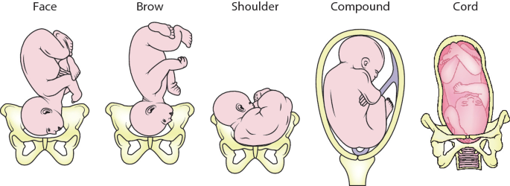

Slide 13
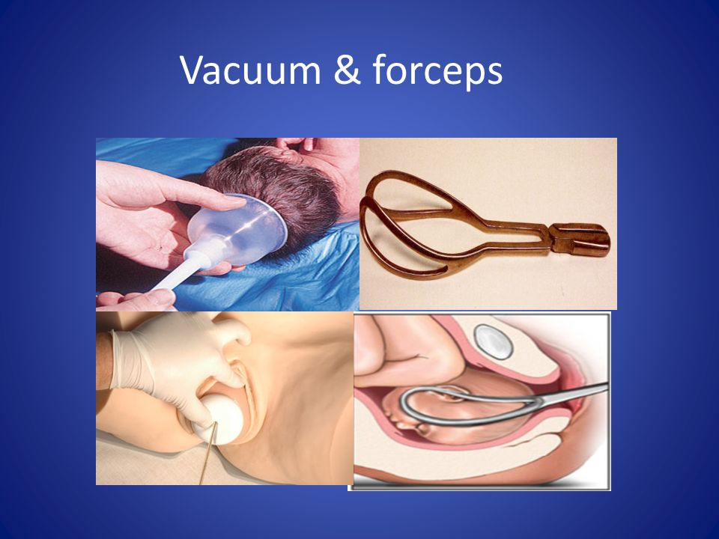

Slide 14
Pathophysiology
Reduced arterial oxygen
Accumulation of co2 ,decrease blood PH
Acidosis occur due to anerobic utilization of glucose

Slide 15
  These biochemical changes result in constriction of pulmonary arteries
  Increased pulmonary arterioles pressure
  Heart failure

Slide 16
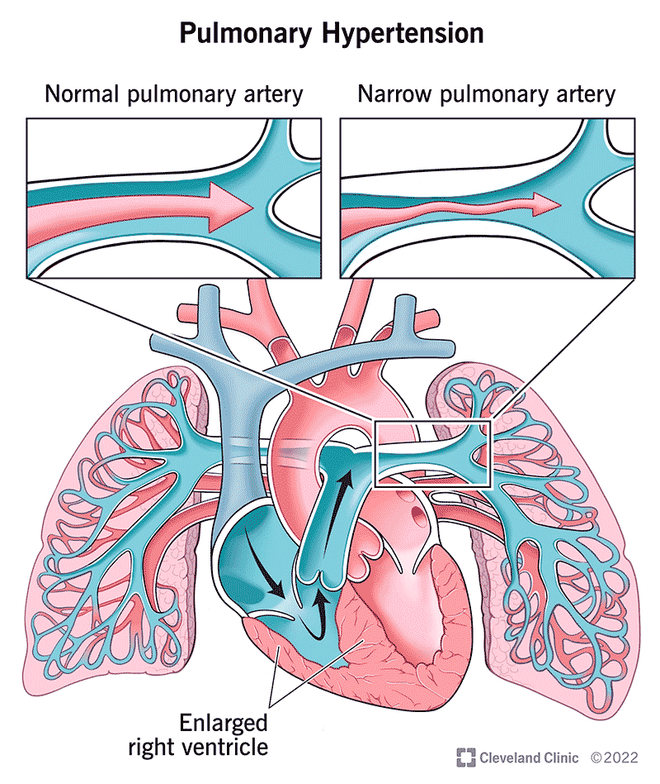

Slide 17
Essential criteria for asphyxia
American college of obstetricians and gynecologist recommend term birth asphyxia require following hypoxia related manifestations.
pH <7(on an umbilical cord arterial blood sample
Apgar score<4 for >5 mins
Neurological sequelae(convulsion, coma hypotonia)
Multi organ dysfunction

Slide 18
Clinical manifestations
Baby may not breathe or have weak breathing
Fetal heart rate slows , pale or bluish skin
Poor muscle tone , weak reflexes seizure may develop
Electronic fetal monitoring : prolonged bradycardia , decreased or absent beat to beat variability
Thick meuconium stained amniotic fluid
Fetal scalp blood analysis shows pH less than 7.2

Slide 19
Effects of asphyxia
System | Effects
Central nervous system | Infarction, intracranial hemorrhage Seizure , cerebral edema
Cardiovascular system | Bradycardia , hypotension , arrythmia, Myocardial ischemia
Respiratory system | Apnea, respiratory distress syndrome , cyanosis
Urinary system | Bladder paralysis, acute tubular necrosis

Slide 20
system | effects
GI system | Necrotizing enterocolitis , stress ulcer
Hematology | Disseminated intravascular coagulation
Metabolic | Hypoglycemia , hypocalcemia hyponatremia
Integument | Subcutaneous fat necrosis

Slide 21
Management
Monitor APGAR scoring.
The oropharynx and the nasopharynx are to be clear off any mucus by suction.
Oxygen is administer when required.
The condition reassessed at 5 minutes and if found normal , the infant should be given to mother .
May need to provide neonatal resuscitation

Slide 22
MANAGEMENT OF ASPHYXIATED NEWBORN ACCORDING TO WHO GUIDELINE
Flow chart 1

Slide 23
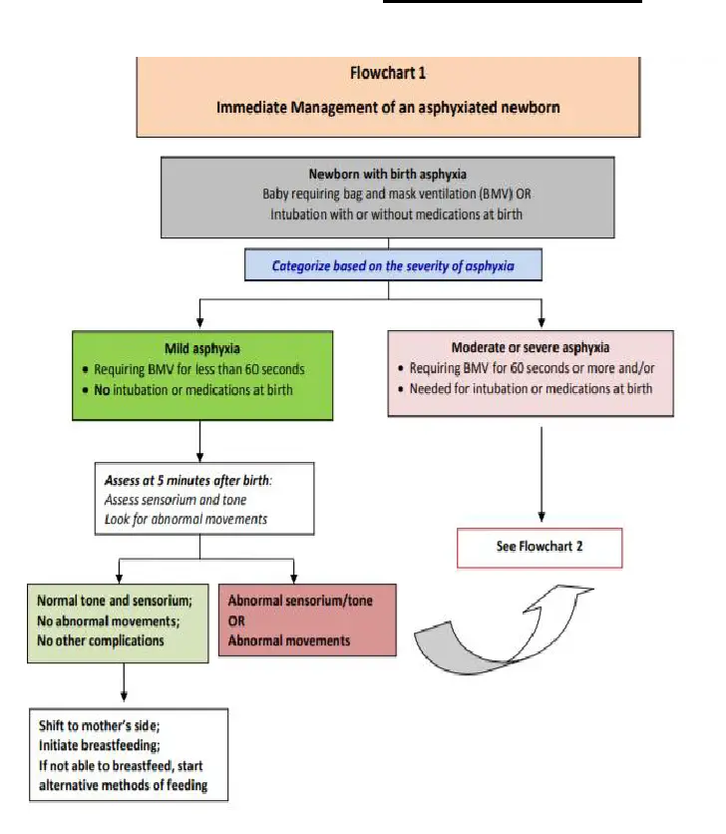

Slide 24
Immediate management of asphyxiated newborn
Baby require (BMV) ,intubation with/without medications
Mild asphyxia | Moderate /severe asphyxia
BMV FOR >60 SECS ,no intubation or medication Assess after 5 mins | BMV for 60 secs or more ,need intubation and medication at birth
Normal tone shift to mother side
Abnormal tone or movements
FLOW CHART 2

Slide 25
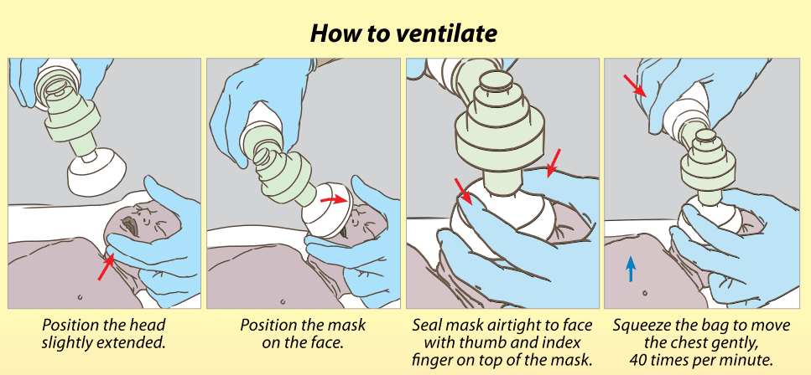

Slide 26
Flowchart 2
check vitals
temperature ,heart rate capillary refill time , O2 saturation , respiratory rate , a normal movements
If any vitals is abnormal management of emergencies

Slide 27
1) Maintain normal temperature : If hypothermia manage by radiant warmer and avoid temp >37.5c
2)Maintain oxygen and ventilation : Secure airway ,start O2 by nasal cannula or hood if spo2 <90, target spo2 (90-95%)
3)Maintain normal perfusion : Administer NS bolus if CRT is prolonged ,assess for blood loss

Slide 28
Assess the infant 8 –hourly until 72 hours (based on consciousness, tone ,seizure , suck ,respiration
Improvement
Deterioration
Initiate alternative methods of feeding, after vitals are stable shift to breastfeeding as soon as possible
Monitor vitals and urine output
Iv fluids
Initiate intra gastric tube feeding
Assess for sepsis ,if the baby does not improve even after 3 days
If no improvement or deterioration REFER

Slide 29
References
Datta P , “Pediatric nursing” 2nd edition (2012) taypee publication.
Wong’s essentials of pediatric nursing.
Maharjan M. , “Comprehensive Textbook of Child Health Nursing” ,first edition (2022) , samiksha publication.
Shrestha T. “ Essential Child Health Nursing”2nd edition , medhavi publication.
Uprety K.” Child Health Nursing” revised edition

Slide 30


